Slide 1
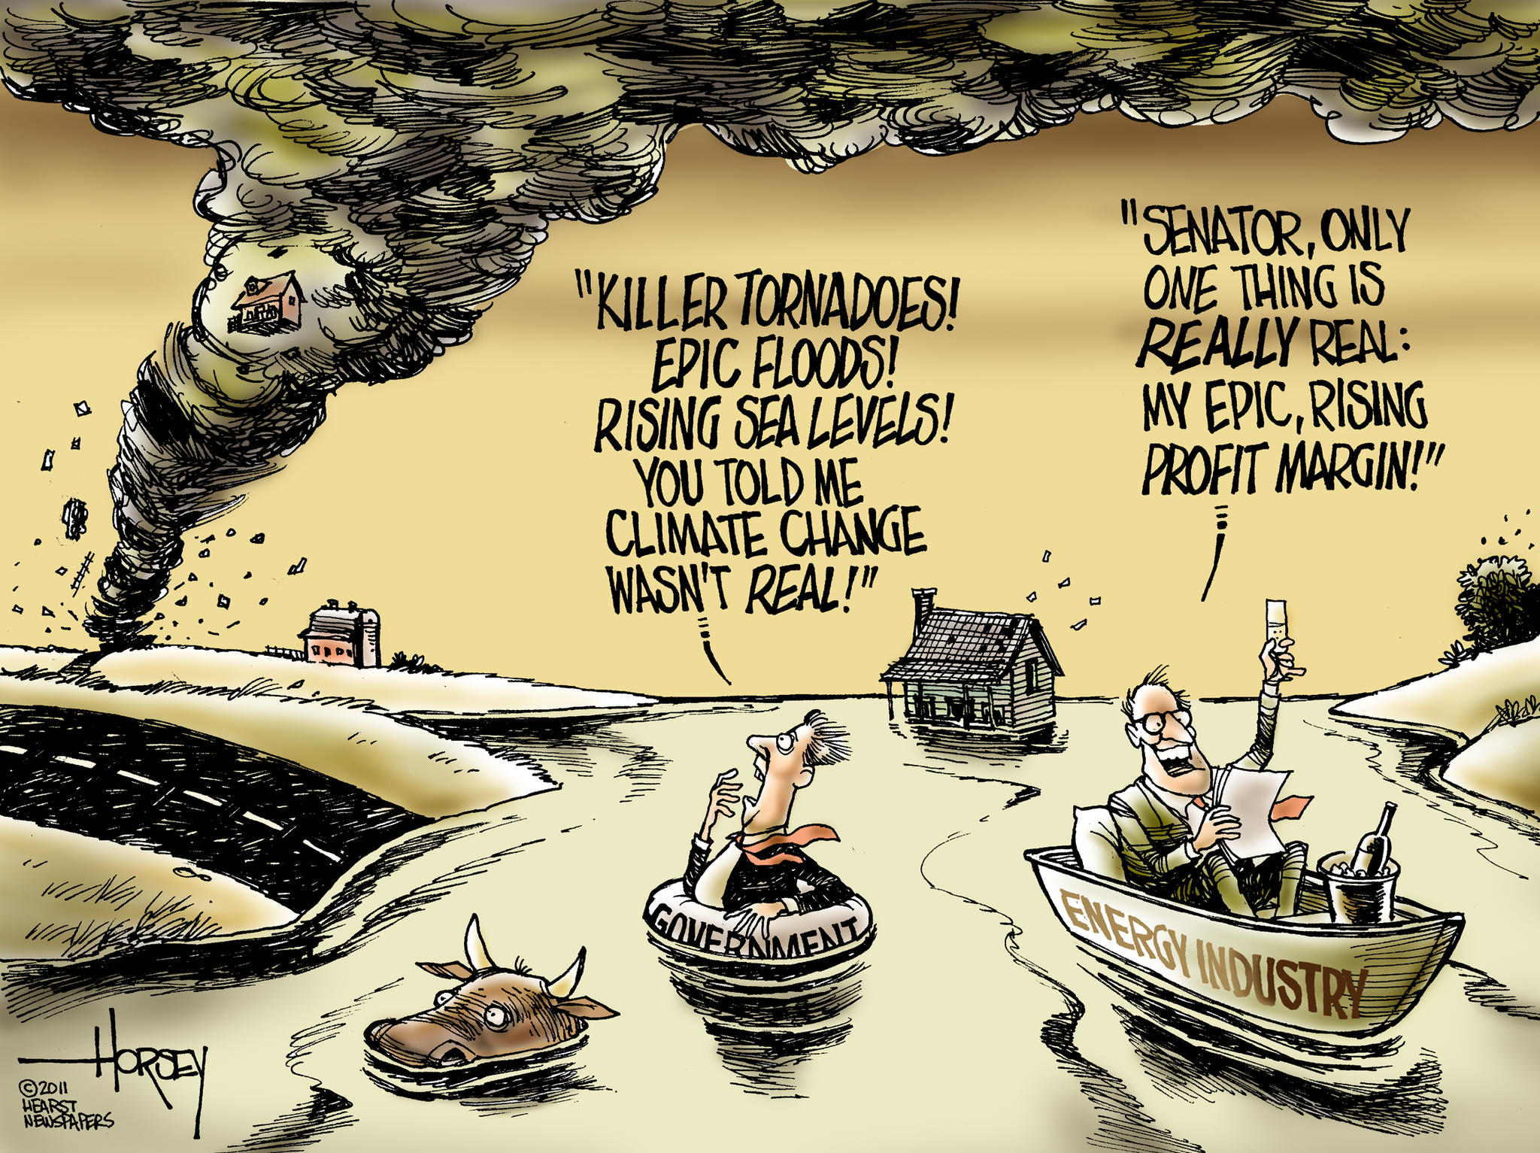

Slide 2
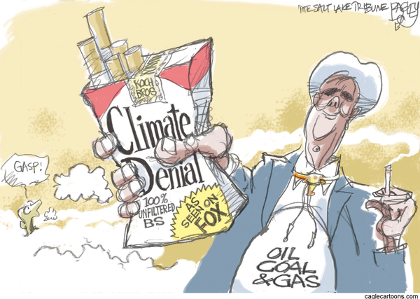

Slide 3
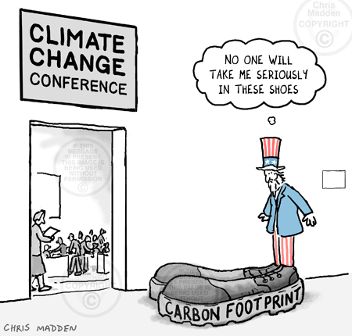

Slide 4
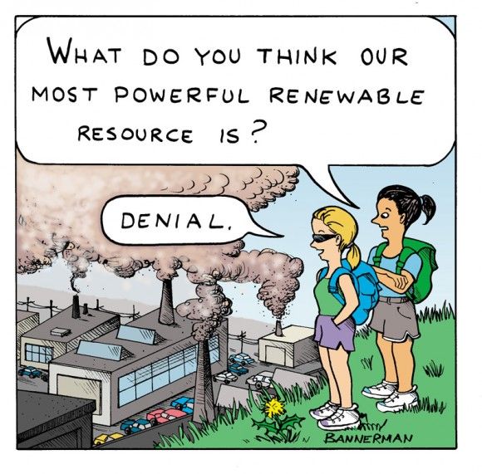

Slide 5
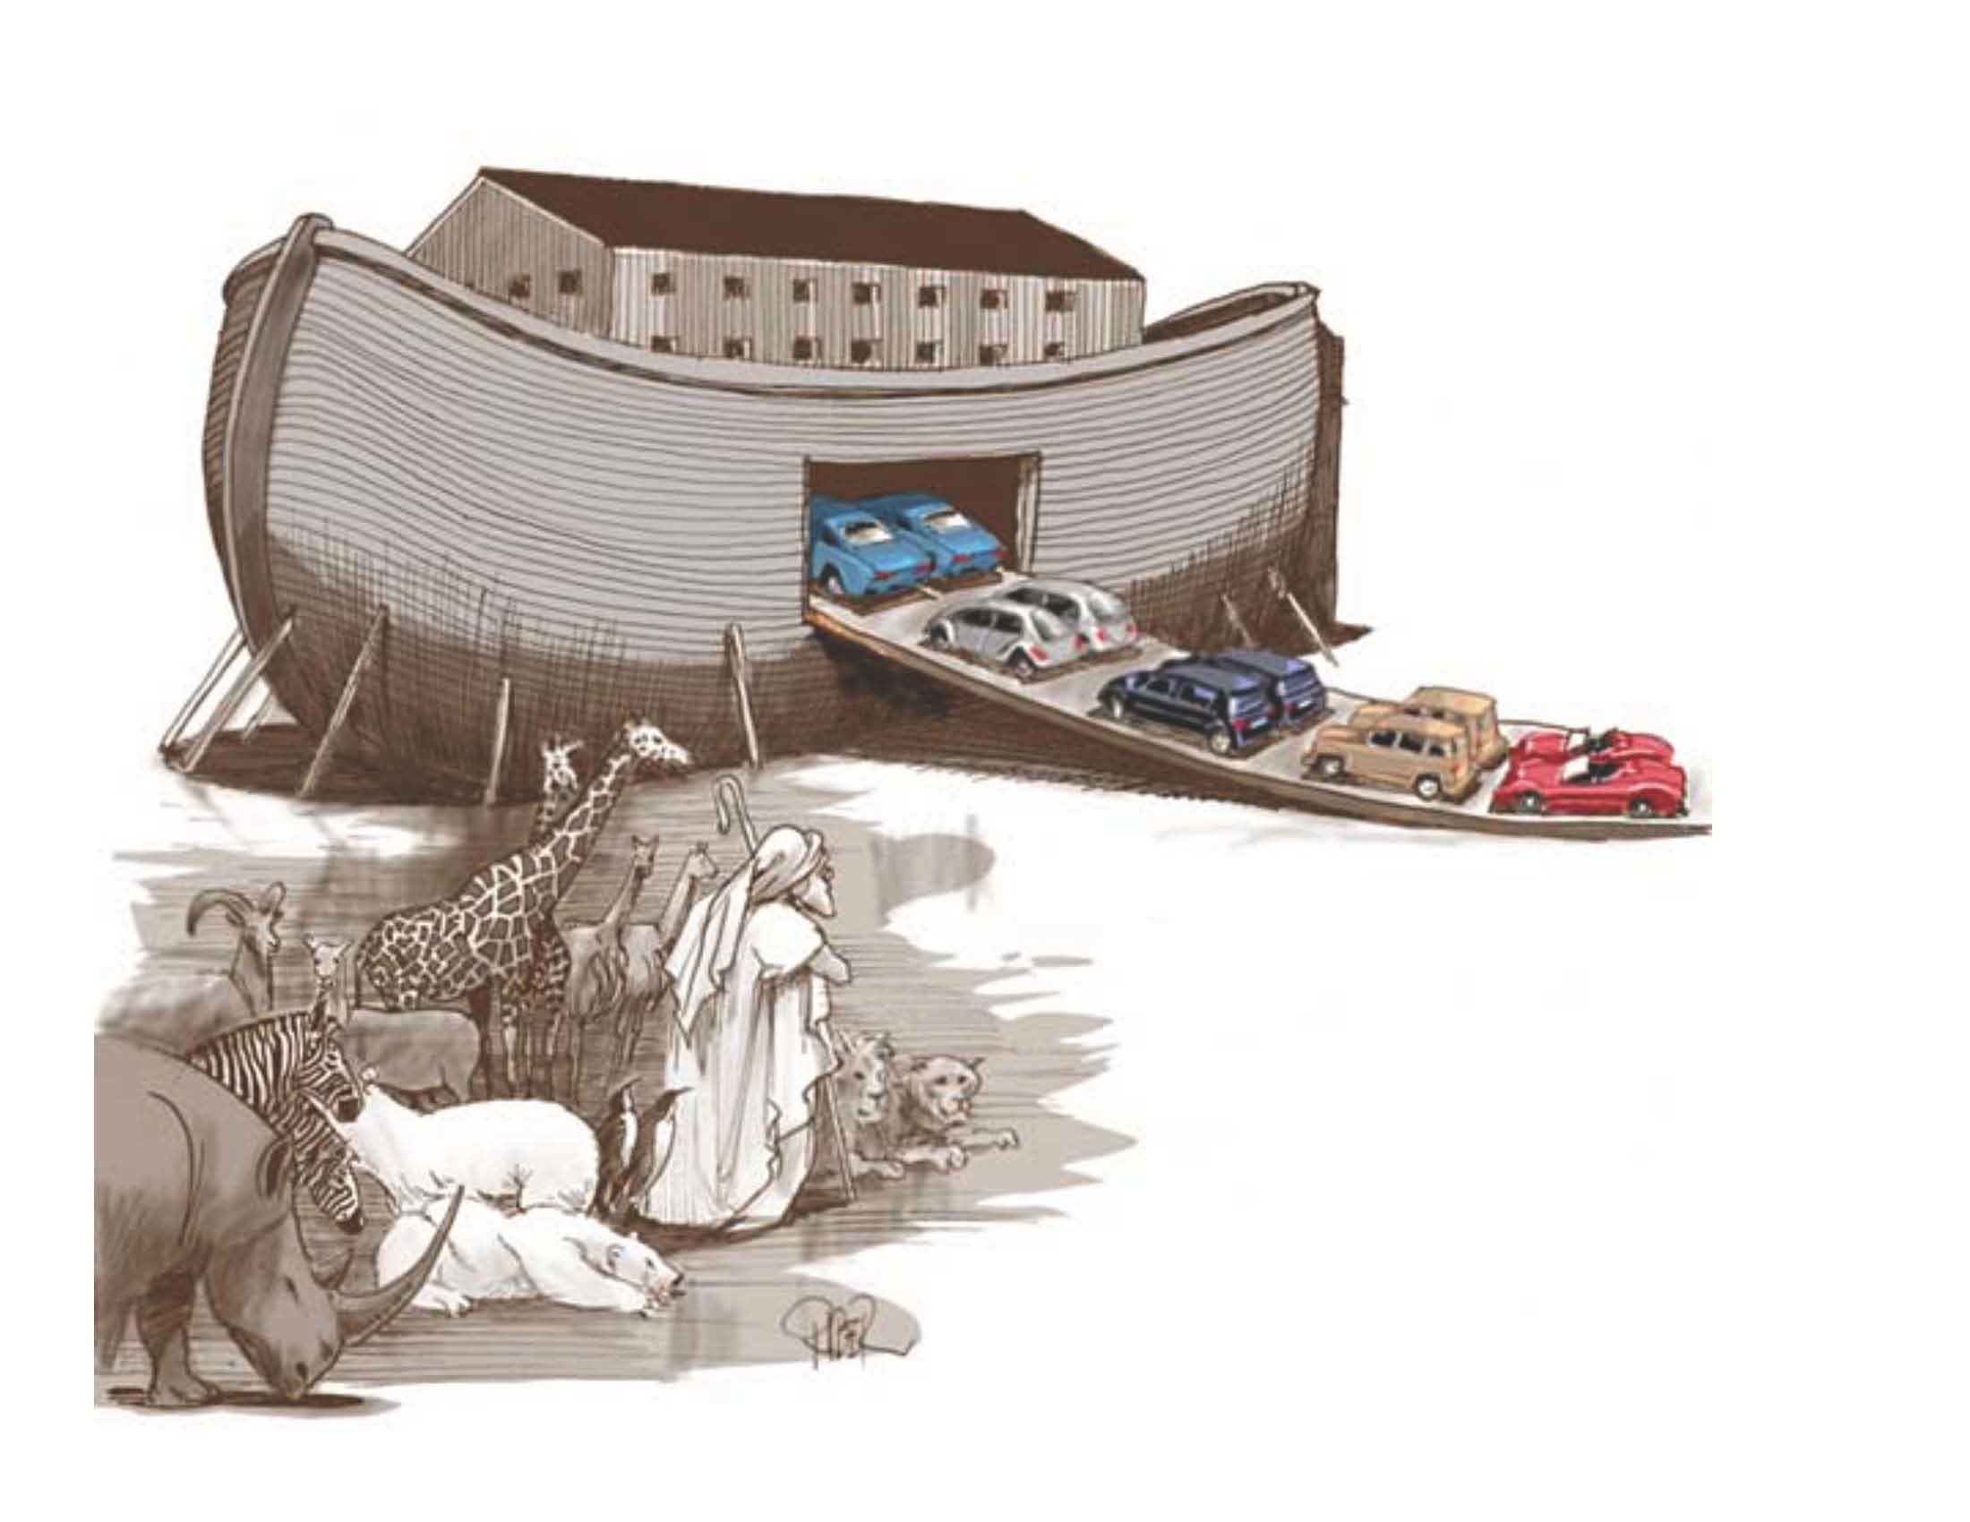

Slide 6
Earth & the Trump Agenda

Slide 7
Global Ecological Collapse
Species Extinction
GMO proliferation
Biocides
Extraction
Climate Change

Slide 8
Extinction

Slide 9
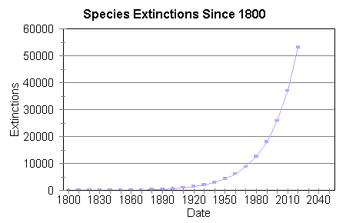

Slide 10
Genetically Modified Organisms

Slide 11
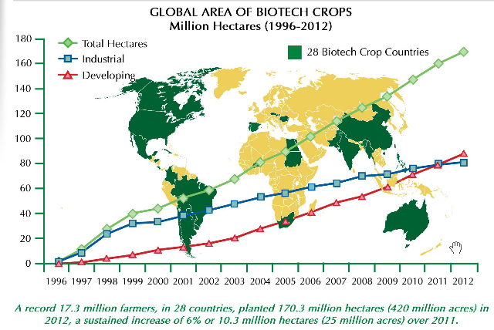

Slide 12
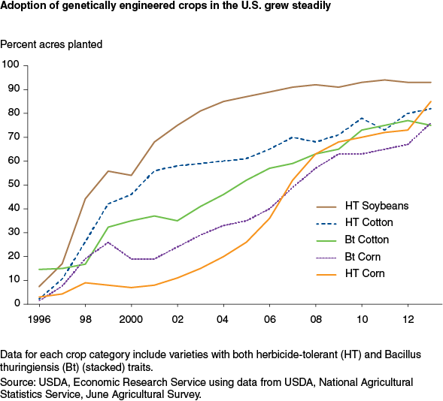

Slide 13
Biocides

Slide 14
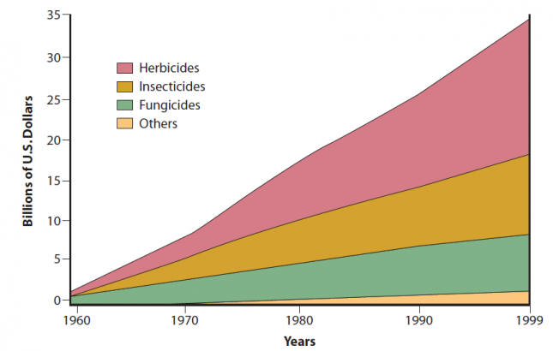

Slide 15
Fossil Fuel Extraction

Slide 16
Climate Change

Slide 17
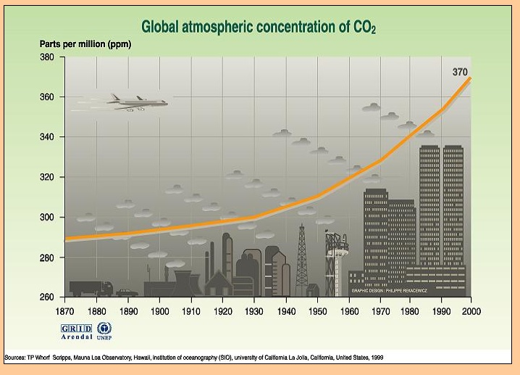

Slide 18
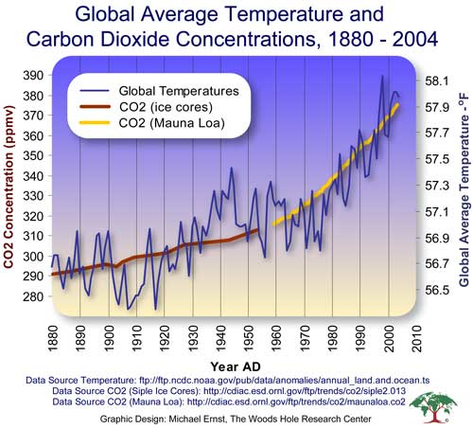

Slide 19
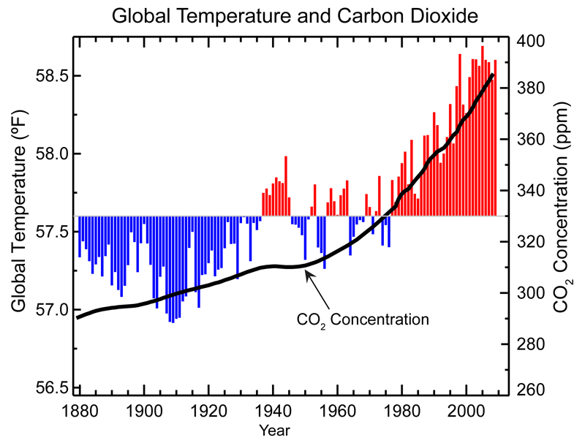

Slide 20
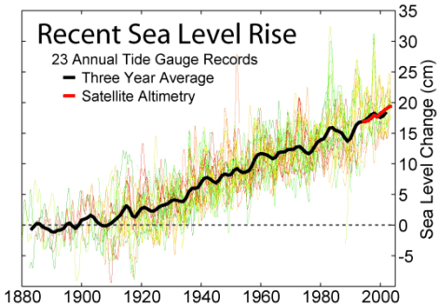

Slide 21
Institutional Failure
Global CO2 emissions from the burning of fossil fuels have increased by 50% since the 1997 Kyoto Protocol.
Global warming appeared as a cover issue in Time & Newsweek in the summer of 1988.
Exxon knew of the link between Global Warming and burning fossil fuels by the end of the 1970s.

Slide 22
Trump is a Climate Change Denier

Slide 23
Trump’s Profound Ignorance:
Q: Would you cut departments?
TRUMP: Environmental Protection, what they do is a disgrace. Every week they come out with new regulations.
Q: Who's going to protect the environment?
TRUMP: We'll be fine with the environment. We can leave a little bit, but you can't destroy businesses.

Slide 24
Trump Environmental Agenda
Dismantle the Environmental Protection Agency
Scrap the Paris Climate Agreement
Build new fossil fuel infrastructure (Keystone Pipeline, DAPL, etc.)
Expand coal, fracking, and offshore oil development
Scrap the Obama/EPA Clean Power Plan (lower CO2 emissions, Renewable energy)
Put the fossil fuel industry in charge of environmental, energy, public lands, and foreign policy

Slide 25
Much of the Trump Environmental agenda comes from the Competitive Enterprise Institute
Reform Environmental Regulation of Private Lands (Gut the Endangered Species Act)
Shrink the Federal Estate (Sell off National Forests or BLM lands)
Unlock Federal Lands (Frack, drill, and mine our way to prosperity)
Restore Resource Production on Federal Lands (Clearcut federal forests)
Remove Climate Planning from Federal Land Policy (Problem? What problem?)

Slide 26
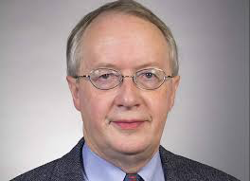
Myron Ebell is Director of Global Warming and International Environmental Policy at the Competitive Enterprise Institute, and guided the environmental policy of the Trump transition team.

Slide 27
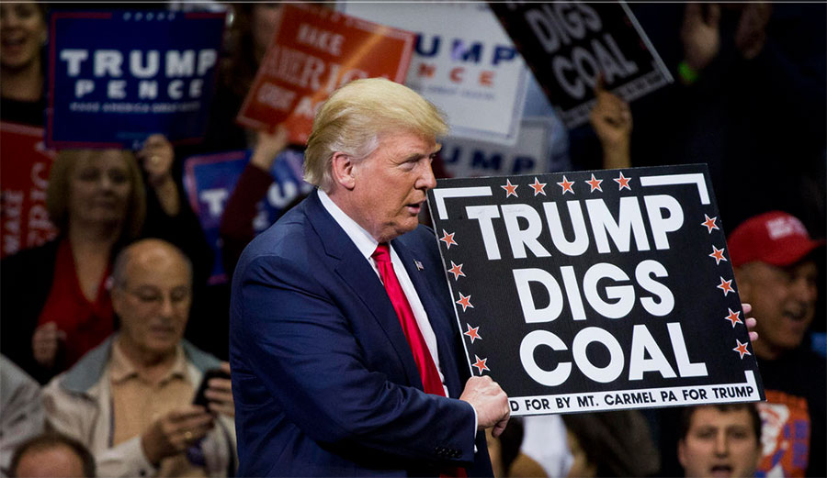

Slide 28
Trump Nominees
Scott Pruitt for EPA Director
Rick Perry for Secretary of Energy
Ryan Zinke for Secretary of the Interior
Sonny Perdue for Secretary of Agriculture
Rex Tillerson fro Secretary of State

Slide 29
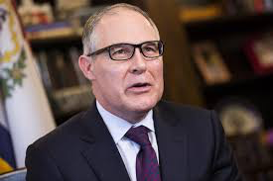
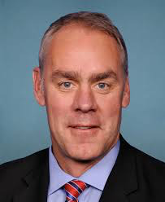
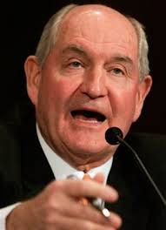
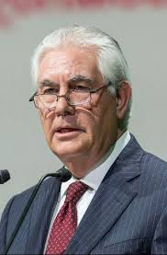
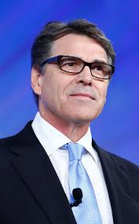

Slide 30
The Administrator of the Environmental Protection Agency is the head of the United States federal government's Environmental Protection Agency, and is thus responsible for enforcing the nation's Clean Air and Clean Water Acts, as well as numerous other environmental statutes.

Slide 31
Scott Pruitt for EPA Director
Repeatedly sued EPA as Oklahoma Attorney General
Climate Change Denier
Fossil fuel industry advocate
Led efforts to block Clean Power Plan
CEO of Fracking Corporation ran his 2013 re-election campaign
Supports DAPL

Slide 32
The Department of Energy responsibilities include the nation's nuclear weapons program, nuclear reactor production for the United States Navy, energy conservation, energy-related research, radioactive waste disposal, and domestic energy production.

Slide 33
Rick Perry for Secretary of Energy
Vowed to abolish Department of Energy (DOE)
Later admitted he did not know what DOE did
Has no background in nuclear issues
Replacing a nuclear physicist
Climate Change Denier
Oil industry has been his primary campaign funder (ExxonMobil, Koch Bros.)
Has called for a moratorium on all regulations
Claimed that EPA was “killing all jobs across America”

Slide 34
The United States Department of the Interior (DOI) is the United States federal executive department of the U.S. government responsible for the management and conservation of most federal land and natural resources, and the administration of programs relating to Native American, Alaska Natives, Native Hawaiians, territorial affairs, and insular areas of the US.

Slide 35
Ryan Zinke for Secretary of the Interior
Supports federal subsidies for fossil fuel development on public lands
Climate Change Denier
Congressional campaign funded by fossil fuel industry
Voted to weaken clean air standards and expand fossil fuel exploration on public lands
Has called for a moratorium on all regulations

Slide 36
The U.S. Department of Agriculture (USDA) is a cabinet-level agency that oversees the American farming industry. USDA duties range from helping farmers with price support subsidies, to inspecting food to ensure the safety of the American public.

Slide 37
Sonny Perdue for Secretary of Agriculture
Nostalgic about the Confederacy
Climate Change Denier
Enacted Voter ID laws
Anti-immigration
Runs a company that trades agricultural commodities globally
Supports expansion of factory farms

Slide 38
The Secretary of State, appointed by the President with the advice and consent of the Senate, is the President's chief foreign affairs adviser. The Secretary carries out the President's foreign policies through the State Department and the Foreign Service of the United States.

Slide 39
Rex Tillerson for Secretary of State
CEO of ExxonMobil, arguably the single most environmentally destructive organization on Earth.
Climate Change Denier
ExxonMobil plays leading role in climate denial machine.
ExxonMobil is under investigation for lying to investors and public about climate change

Slide 40
The Climate Change Denial Machine Seizes the US Government

Slide 41
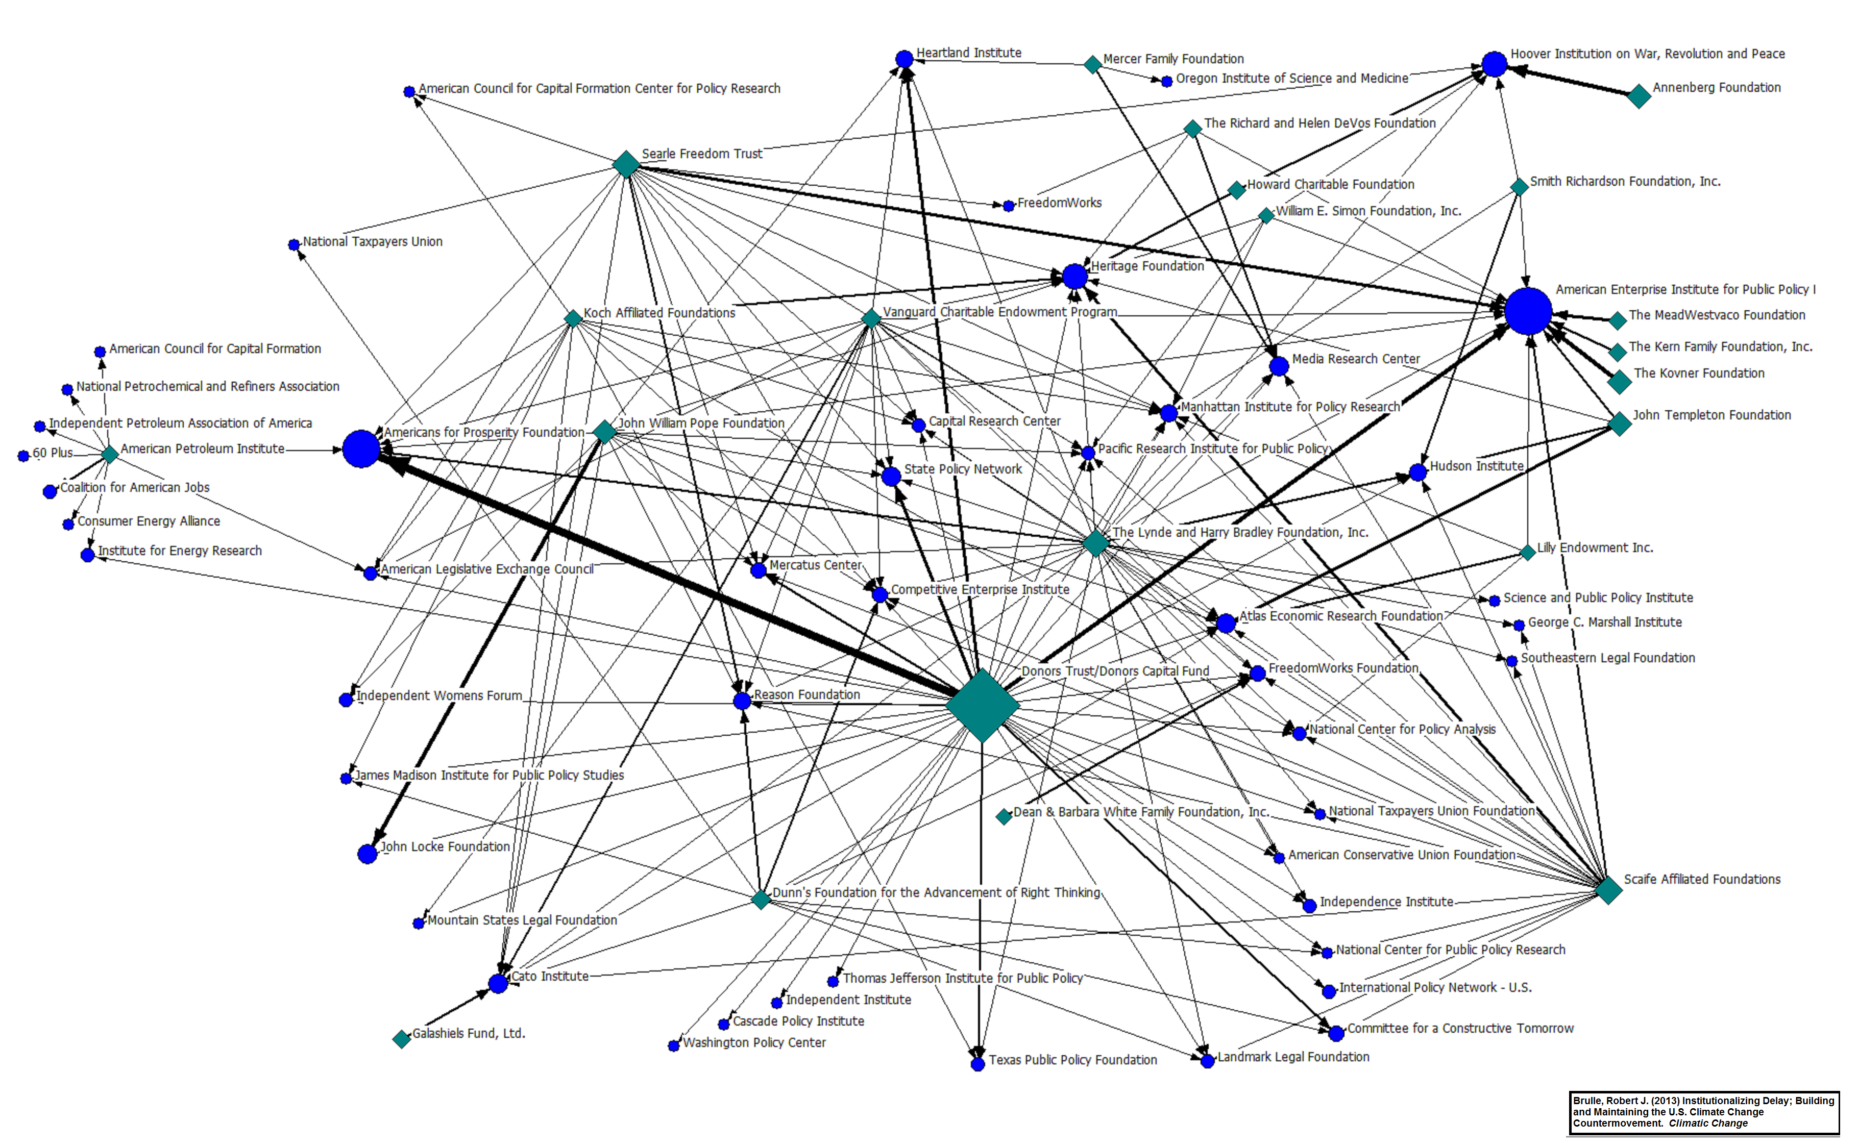

Slide 43
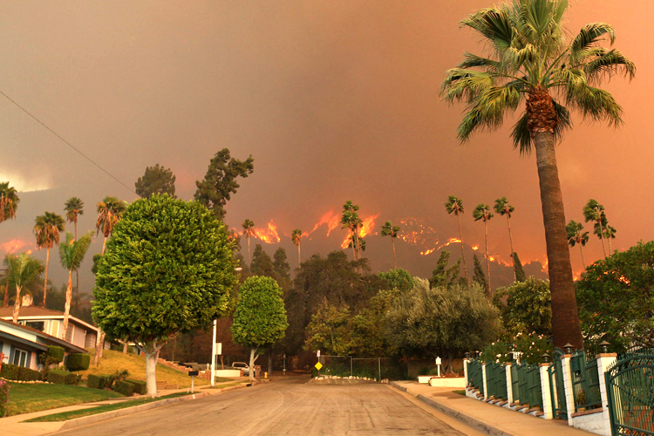
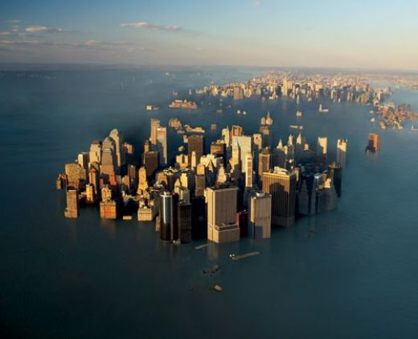
The Trump Administration
will be noticeable
in the fossil record of our civilization
unless defeated

Slide 44
Global Mobilization

Slide 45
350brooklyn.org
Next Meeting: Thursday, February 9, 7:30 pm
Meetings on the second Thursday of each month.
Brooklyn Commons. 388 Atlantic Avenue between Bond and Hoyt Streets

Slide 46
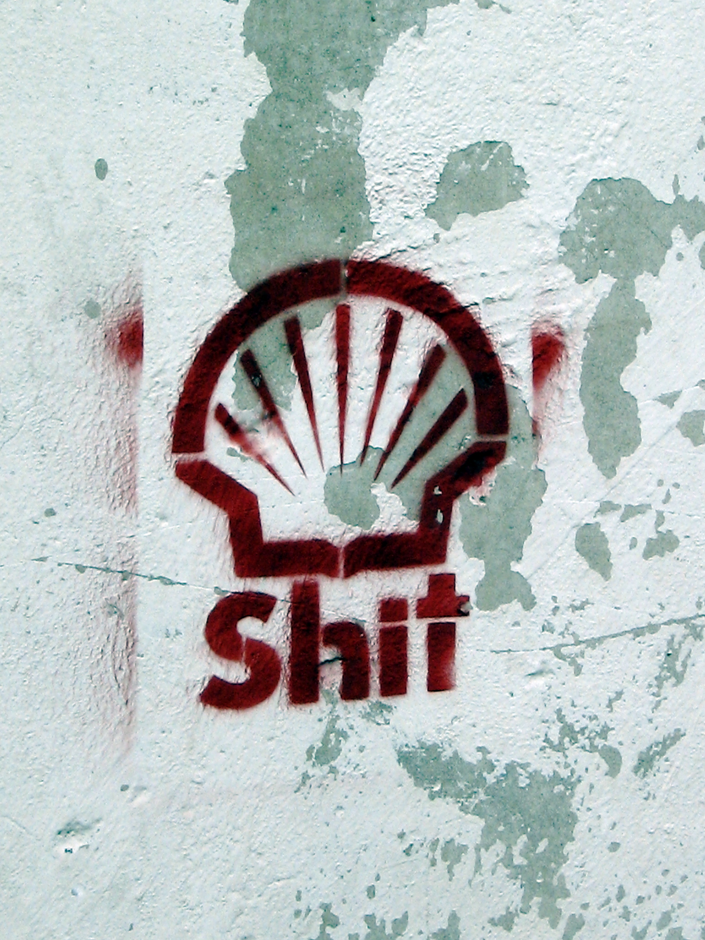

Slide 47
peoplesclimate.org
People’s Climate March, April 29, 2017 in Washington DC
32BJ SEIU, 350.org, Alliance for Climate Education, BlueGreen Alliance, Center for Biological Diversity, Center for Community Change, Center for Popular Democracy, Chesapeake Climate Action Network, Chispa, Climate Justice Alliance, The Climate Reality Project, Color of Change, Emerald Cities, Franciscan Action Network, Grassroots Global Justice, GreenFaith, GreenLatinos, Hip Hop Caucus, Indigenous Environmental Network, Labor Network for Sustainability, League of Conservation Voters, Moms Clean Air Force, NAACP, Natural Resources Defense Council, People’s Action, People’s Collective Arts/Colectivo de Arte Popular, People’s Climate Movement NY, Power Shift Network, Public Citizen, Service Employees International Union, Sierra Club, Union of Concerned Scientists, US Climate Action Network

Slide 48
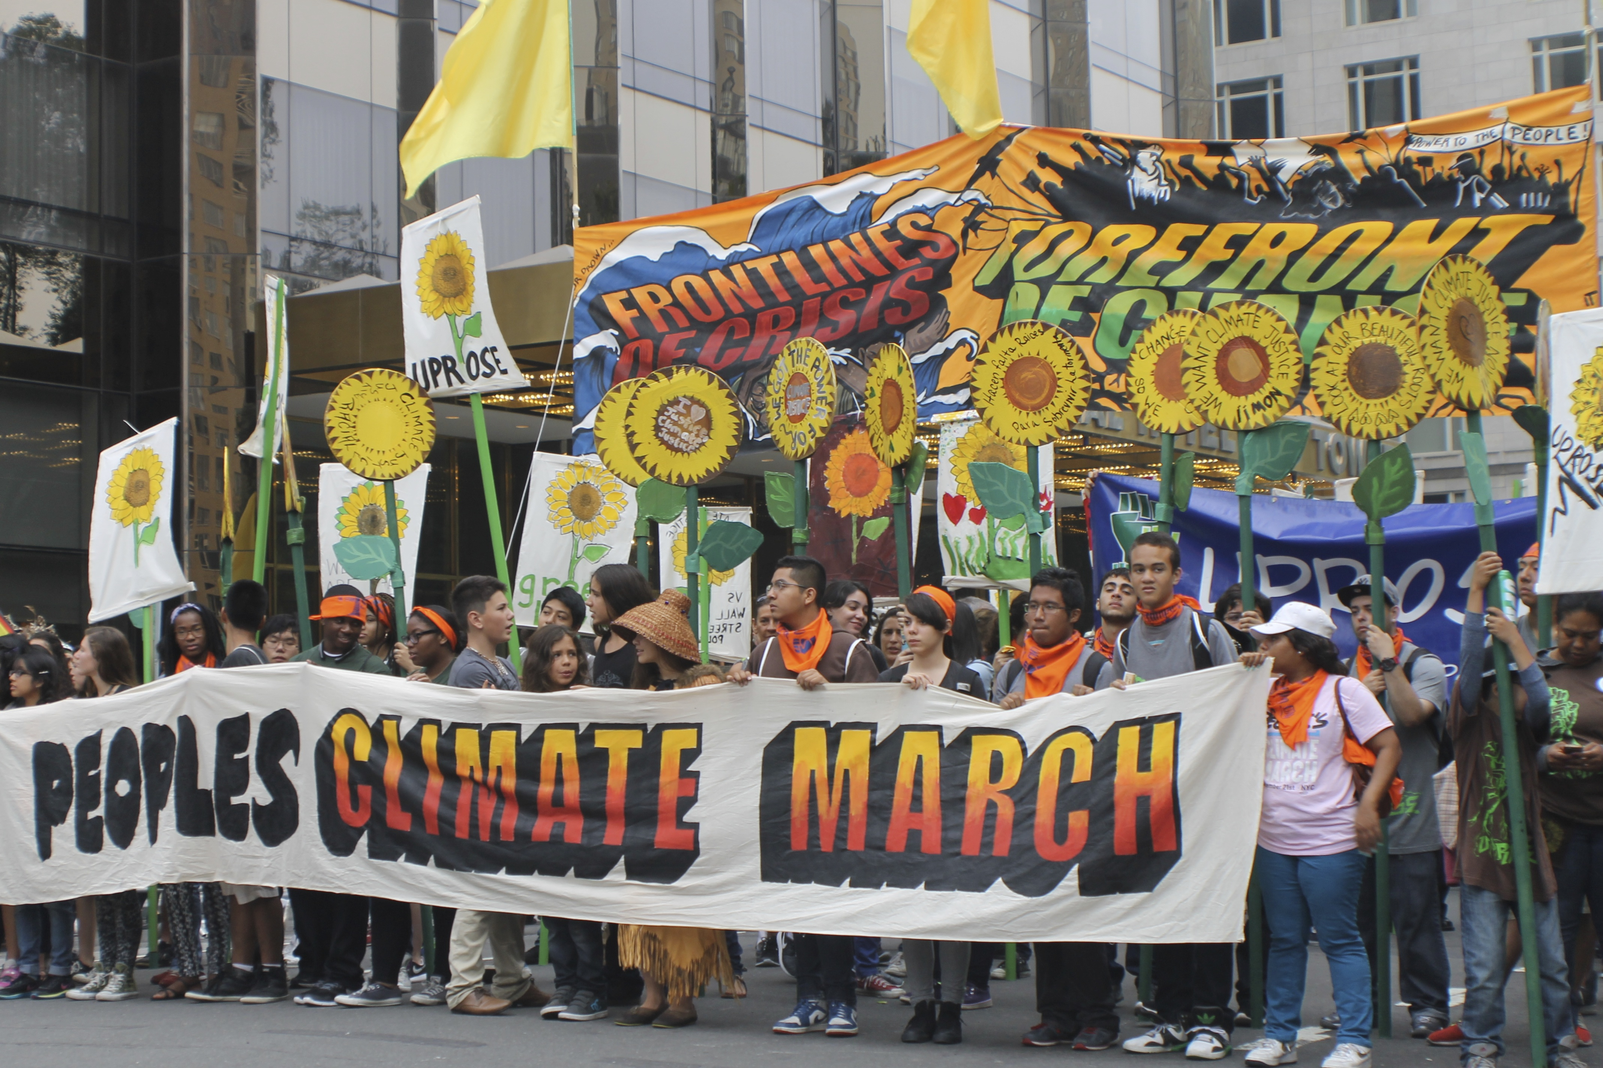

Slide 49
uprose.org
Our intergenerational work encompasses a variety of environmental justice, climate justice and public health initiatives.
From the development of the waterfront and local brownfields, to transportation, open space and air quality needs, to educational and youth empowerment campaigns, our team has been fighting for Climate Justice.

Slide 50
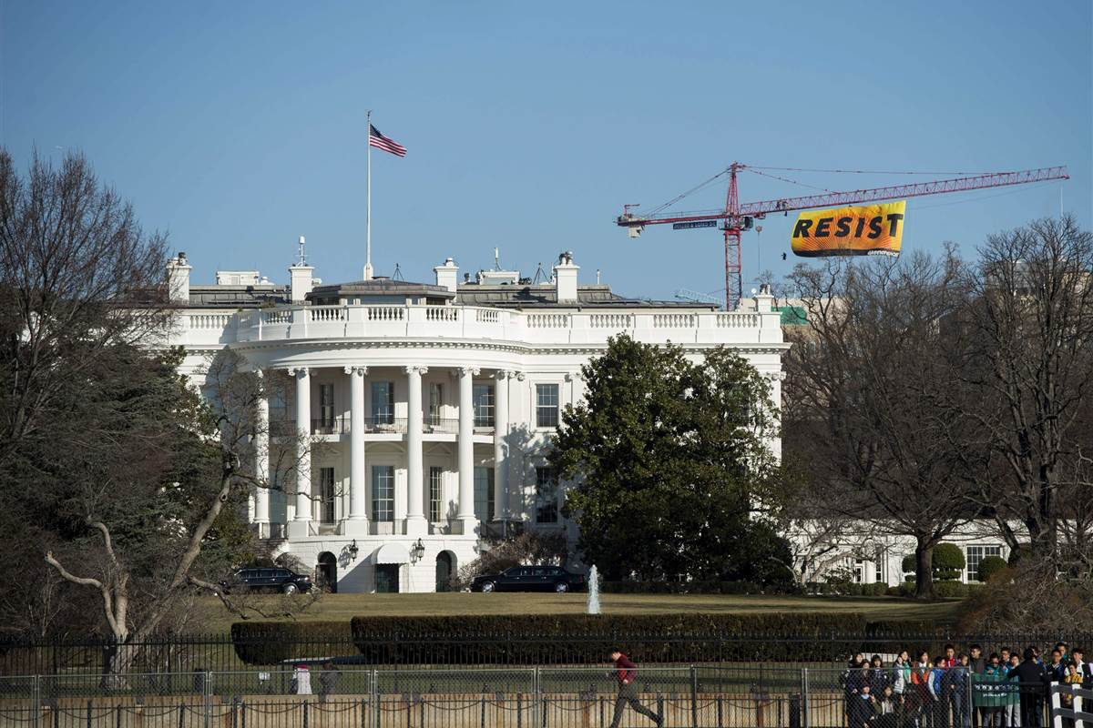

Slide 51
Gillibrand, Kirsten E. - (D – NY)
478 Russell Senate Office Building Washington DC 20510
(202) 224-4451
Contact: www.gillibrand.senate.gov/contact/
Schumer, Charles E. - (D - NY)
322 Hart Senate Office Building Washington DC 20510
(202) 224-6542
Contact: www.schumer.senate.gov/contact/email-chuck

Slide 52
